Slide 1
TOPIC A4:
MACHINE LEARNING
LESSON A4-1
WHAT MACHINE LEARNING IS

Slide 2
AGENDA
Warm up
What machine learning is
Training data and labels
Supervised learning
Unsupervised learning
Reinforcement learning
Choosing the type
Deep learning
Transfer learning
Real-world applications
Lab
Close
WHAT U NEED 4 LESSON
Guided Notes
ur hedz

Slide 3
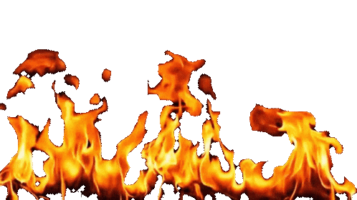
WARM UP QUESTION
(a) State the role of a GPU in a computer [1]
(b) State one task a GPU is better suited to than a CPU [1]
(c) State what is meant by an algorithm [1]
→ Notes Q1 (a), (b), (c)

Slide 4
WARM UP ANSWER
(a) It performs many simple calculations in parallel
(b) Anything with thousands of identical sums, such as shading pixels, or training a model
(c) A finite sequence of steps that solves a problem

Slide 5

WHAT MACHINE LEARNING IS
Normally you write every step yourself and the computer follows them exactly
  This is an algorithm
That works whenever you can describe the rule, such as “sort a list”, “count the pages in my fanfic”
Some jobs have a rule you cannot write down
  “Is this photo a cat?” has no sequence of steps you could type out
    Yes, I know about dichotomous keys but a computer doesn’t know how to use those

Slide 6
WHAT MACHINE LEARNING IS
Machine learning is a program that works the rule out for itself
  a program that improves at a task by finding patterns in data, rather than following rules a programmer wrote

Slide 7
WHAT MACHINE LEARNING IS
I have a challenge for you:
  Come up with a set of rules to block scam emails

Slide 8
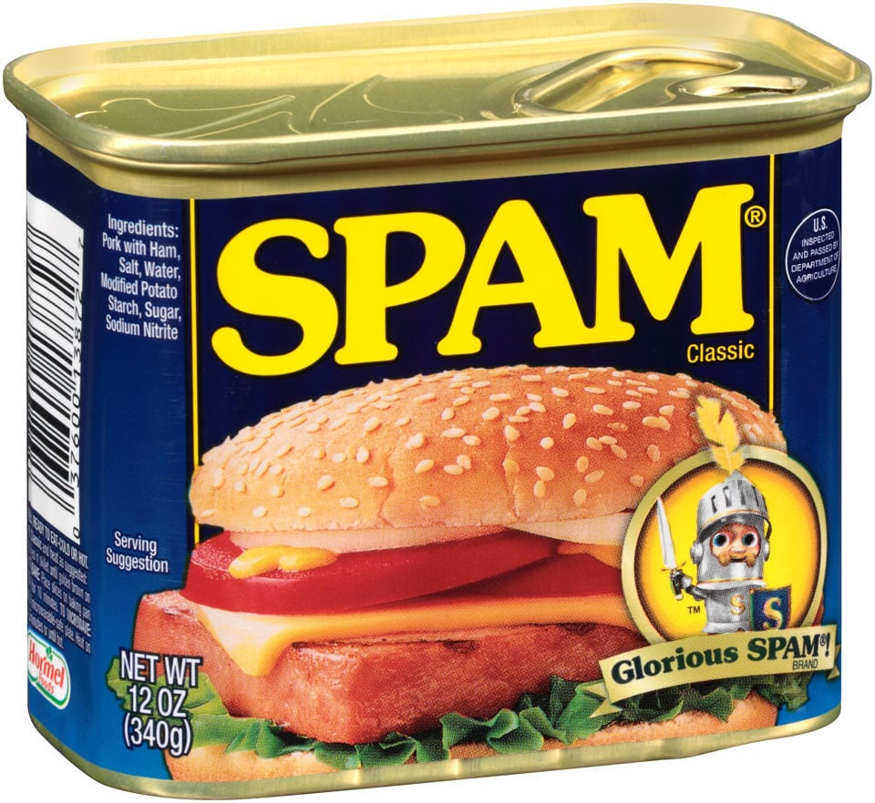
WHAT MACHINE LEARNING IS
Let’s say we block anything containing “free money” or “Nigerian prince”
  If the scammer writes “fr33 m0ney” and your rule is already dead
You add a rule, they change a word, you add a rule, they change a word
  It becomes unsustainable
The real way that we can know something is spam is too complicated and changes too often to write by hand
So instead, you can give a machine learning program 10,000 emails already marked spam or not spam, and it finds the pattern itself

Slide 9
WHAT MACHINE LEARNING IS
for bonus (not actually) points, can anybody tell me why spam emails are called spam?

Slide 10

WHAT MACHINE LEARNING IS

Slide 11
WHAT MACHINE LEARNING IS
The same job, done two different ways
 | Creating Rules Ourselves | Creating a Machine Learning Model
Who finds the pattern | You do | The program does
What you supply | Logic you wrote | Examples you collected
When things change | You rewrite the code | You retrain it
What you end up with | A program | A model

Slide 12
TRAINING DATA AND LABELS
Training data is the set of examples you give the program to learn from
Each example is described by its features - the measurements you chose to record
  A piece of fruit might have two: weight and redness
A label is the correct answer for that example, written on it in advance by a person, typically in the form of metadata
The label is NOT worked out by the computer
  It was attached before training started
So one training example is: weight 150 g, redness 8, and a human has already tagged it APPLE

Slide 13
TRAINING DATA AND LABELS
In this training data table, the first two columns are features
The last column is the label, added ahead of time by a person
Example | Weight (g) | Redness (0–10) | Label
Example 1 | 150 | 8 | APPLE
Example 2 | 95 | 9 | TOMATO
Example 3 | 180 | 9 | APPLE

Slide 14
TRAINING DATA AND LABELS
Tagging data is slow, expensive human work
Somebody, probably in a third world country, underpaid, sits and marked ten thousand X-rays one at a time
  The limit for training an AI model like this is typically labelled data, rather than raw computing power
What comes out of training is a model: the program that makes predictions on data it has never seen
The whole process: collect training data → train → get a model → give it new data → it predicts based on those results
→ Notes Q2 and Q3

Slide 15


SUPERVISED LEARNING
Supervised learning - every training example given is already tagged with the right answer
The program makes a prediction, compares it to the tag, sees how wrong it was, and adjusts
It is called supervised because those tags act like a teacher, grading the program’s attempts
For our purposes, supervised learning will be represented by this strict teacher lady and this scared kid

Slide 16
SUPERVISED LEARNING
Supervised learning involves two tasks:
  Classification, predicting a category such as spam or not spam
  Regression, predicting a number, such as tomorrow’s temperature
Supervised learning CANNOT begin without labeled data, making it costly to get up and running

Slide 17
SUPERVISED LEARNING
Given five tagged examples with two types of labels, the program looks for what separates the two labels.
Weight (g) | Redness | Label
150 | 8 | APPLE
120 | 7 | APPLE
95 | 9 | TOMATO | Pattern found:
85 | 8 | TOMATO | over about 115 g
180 | 9 | APPLE | means APPLE

Slide 18
UNSUPERVISED LEARNING
Unsupervised learning - the training data arrives with no tags at all
Because there isn’t any data given by humans, the program has no way of knowing if it’s correct or not
  All it can do is work out which examples resemble each other, and put those together
  This is called Clustering

Slide 19
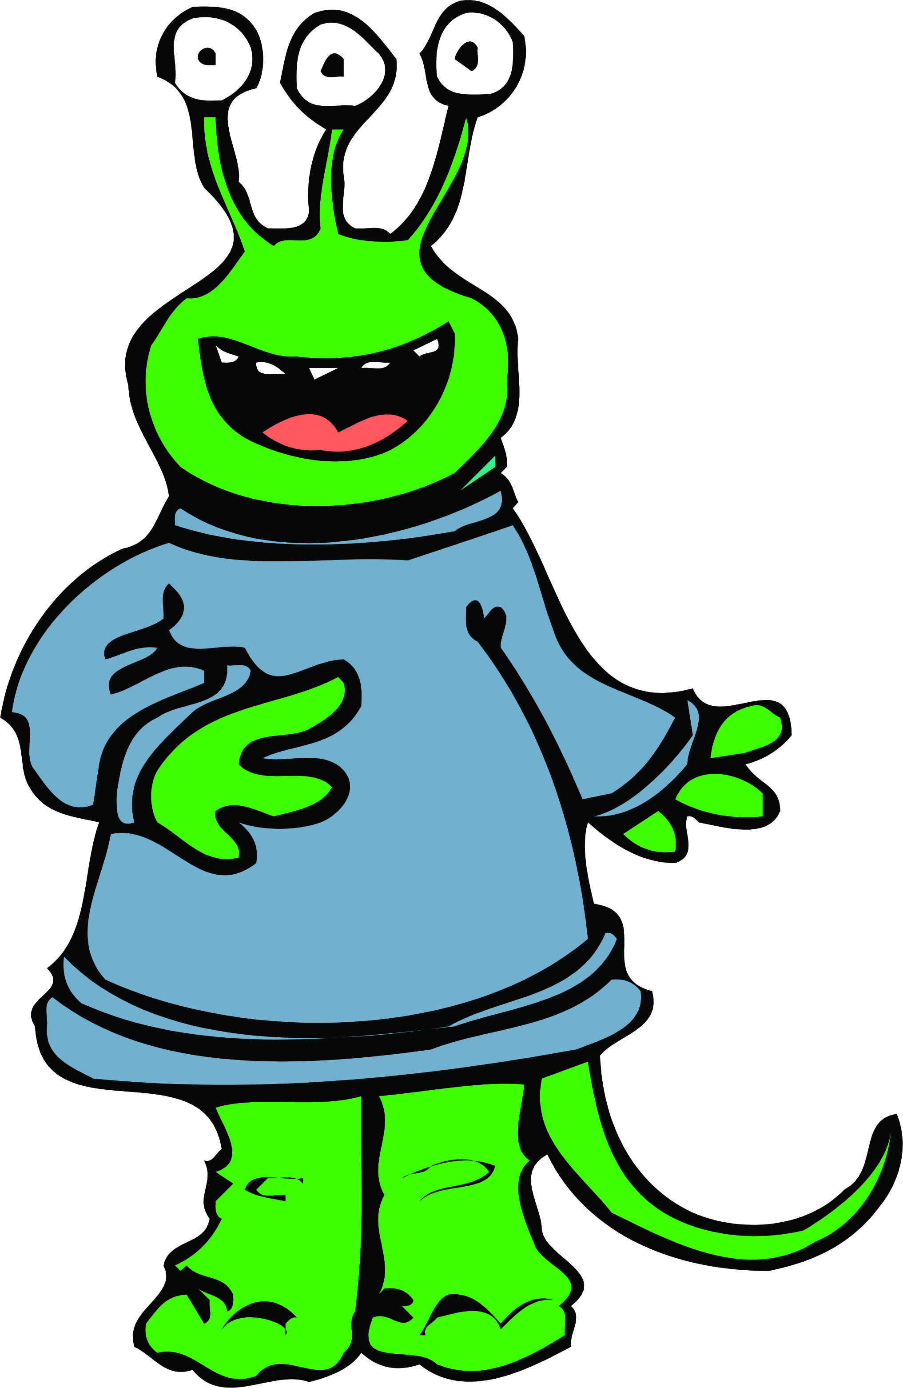
UNSUPERVISED LEARNING
Even though it can find groupings of similar data, it still has zero clue what any of it is, when a person could intuit it easily
This is used when tagging would be impossible: such as going through millions of supermarket receipts to categorize them
For our purposes, this will be the friendly alien
  He just doesn’t ‘get’ us

Slide 20

REINFORCEMENT LEARNING
Reinforcement learning - there is no data set to start with at all
  An ‘agent’ takes an action inside an environment, and gets a reward, which is just a score, after each one
It isn’t told what to do, but is simply given feedback on its results
Over thousands of attempts it builds a policy - a strategy for choosing the next action
This is used where nobody knows the right answer but success can be measured: playing a game, steering a robot
For us, this will be a human baby

Slide 21
CHOOSING THE TYPE
The type is decided by what comes attached to the data, not by how clever the program is
→ Notes Q4 (a), (b), (c) and (d)
 | Supervised | Unsupervised | Reinforcement
Data arrives | Tagged in advance | With no tags | There is no data
It learns from | The tags | Similarity | A score
The job | Predict the tag | Find the groups | Raise the score
Example | Is this spam? | Which shoppers are alike? | Win the game

Slide 22
CHOOSING THE TYPE
Four scenarios. Say the type, then say what gave it away.
→ Notes Q5
The scenario | What comes with the data?
10,000 X-rays, each marked by a doctor as clear or not
A year of purchases with no categories; find the shopper types
A robot arm that scores points for stacking a block

Slide 23
DEEP LEARNING
Deep learning is NOT another type of scenario that we can train a machine on
  Our last three describe the problem: what came attached to the data
Deep learning describes the model itself: a neural network built from many layers stacked on top of each other
More layers lets it capture more complicated patterns, but it needs far more data and far more computing power
A deep network can be trained supervised, unsupervised or reinforcement
  A question like “is it deep learning or supervised learning?” is flawed

Slide 24
TRANSFER LEARNING
Transfer learning also answers a different question: where did training start?
  Normally you start from a model that knows nothing whatsoever
Instead, transfer learning takes a model somebody already trained on a gargantuan data set, and retrain only its last part on your own much smaller one
Its early layers already recognise general things such as edges, shapes, textures, meaning you won’t have to train those parts yourself
  Far less data, far less time, far less hardware
→ Notes Q6 (a), (b) and (c)

Slide 25
REAL-WORLD APPLICATIONS
These are some specific use cases noted by the IB
→ Notes Q7 (a) and (b)
Application | Type | What it learned from
Medical imaging diagnostics | Supervised | Scans tagged by doctors
Market basket analysis | Unsupervised | Till receipts, no tags
Sentiment analysis | Supervised | Reviews tagged positive or negative
Object detection | Supervised | Photos with boxes drawn on them
Robotics navigation | Reinforcement | A score for not crashing

Slide 26
LAB
→ Notes Q8 and Q9
Q8 Explain why a task with no tagged examples cannot be solved using supervised learning [3]
Q9 A shop wants to recommend products from what similar customers bought. Identify the type of learning and justify your answer [3]

Slide 27
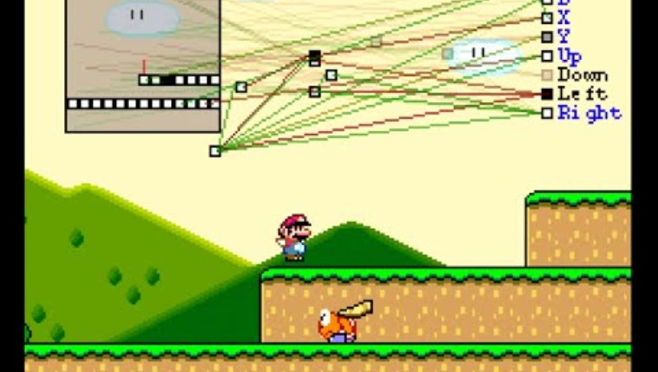
VIDEO

Slide 28
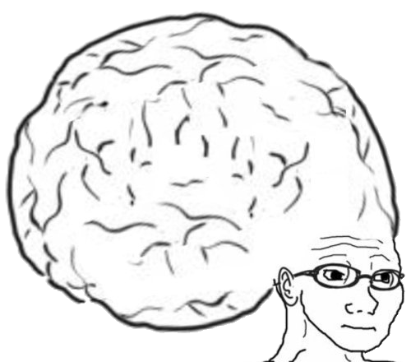
VOCABULARY TO REMEMBER
Machine learning
Training data
Feature
Label
Model
Supervised learning
Classification
Unsupervised learning
Clustering
Reinforcement learning
Agent
Environment
Reward
Policy
Deep learning
Neural network
Transfer learning

